Slide 1

Building Scalable IMS LTI Tools Using the TSUGI Framework
Charles Severance
www.dr-chuck.com
www.tsugi.org

Slide 2
Disclaimer...
What I am about to talk about is not an official direction or position of the University of Michigan, Longsight, nor IMS Global.

Slide 3


3

Slide 4
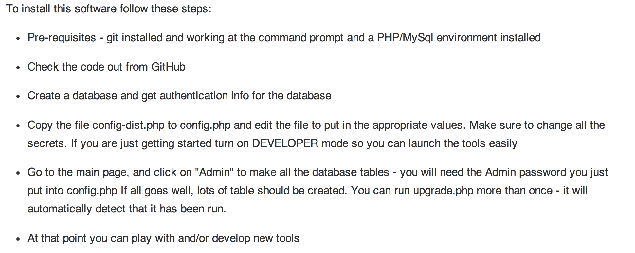
Installation Instructions
www.tsugi.org

Slide 5
Project Tsugi
Tool Hosting Container (i.e. Like a B2)
PHP now, Java planned
Based on IMS Specifications
LTI 1.x / LTI 2.x / IMS Settings / Common Cartridge / Caliper / CASA / Roster / Gradebook / ....
Tools can run on a campus hosting platform or commercial provider or cloud
Tools are "installed" into hosting containers

Slide 6
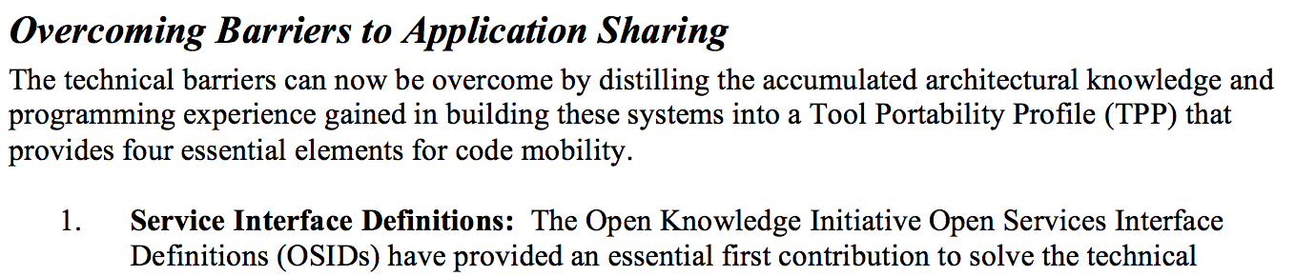
From the 2003 Sakai Proposal
http://www-personal.umich.edu/~csev/papers/2004/2004_03_01_mellon_sakai_proposal.pdf

Slide 7


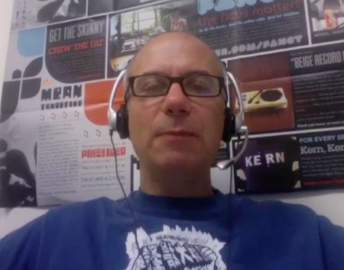


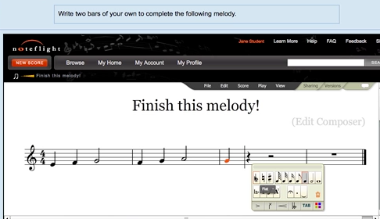




WTD?
...

Slide 8

L
T
I
PHP
Java
C#
...
But...

Slide 9






"Large Midwestern University"
Sakai
.......
Looks pretty cool.... But...

Slide 10
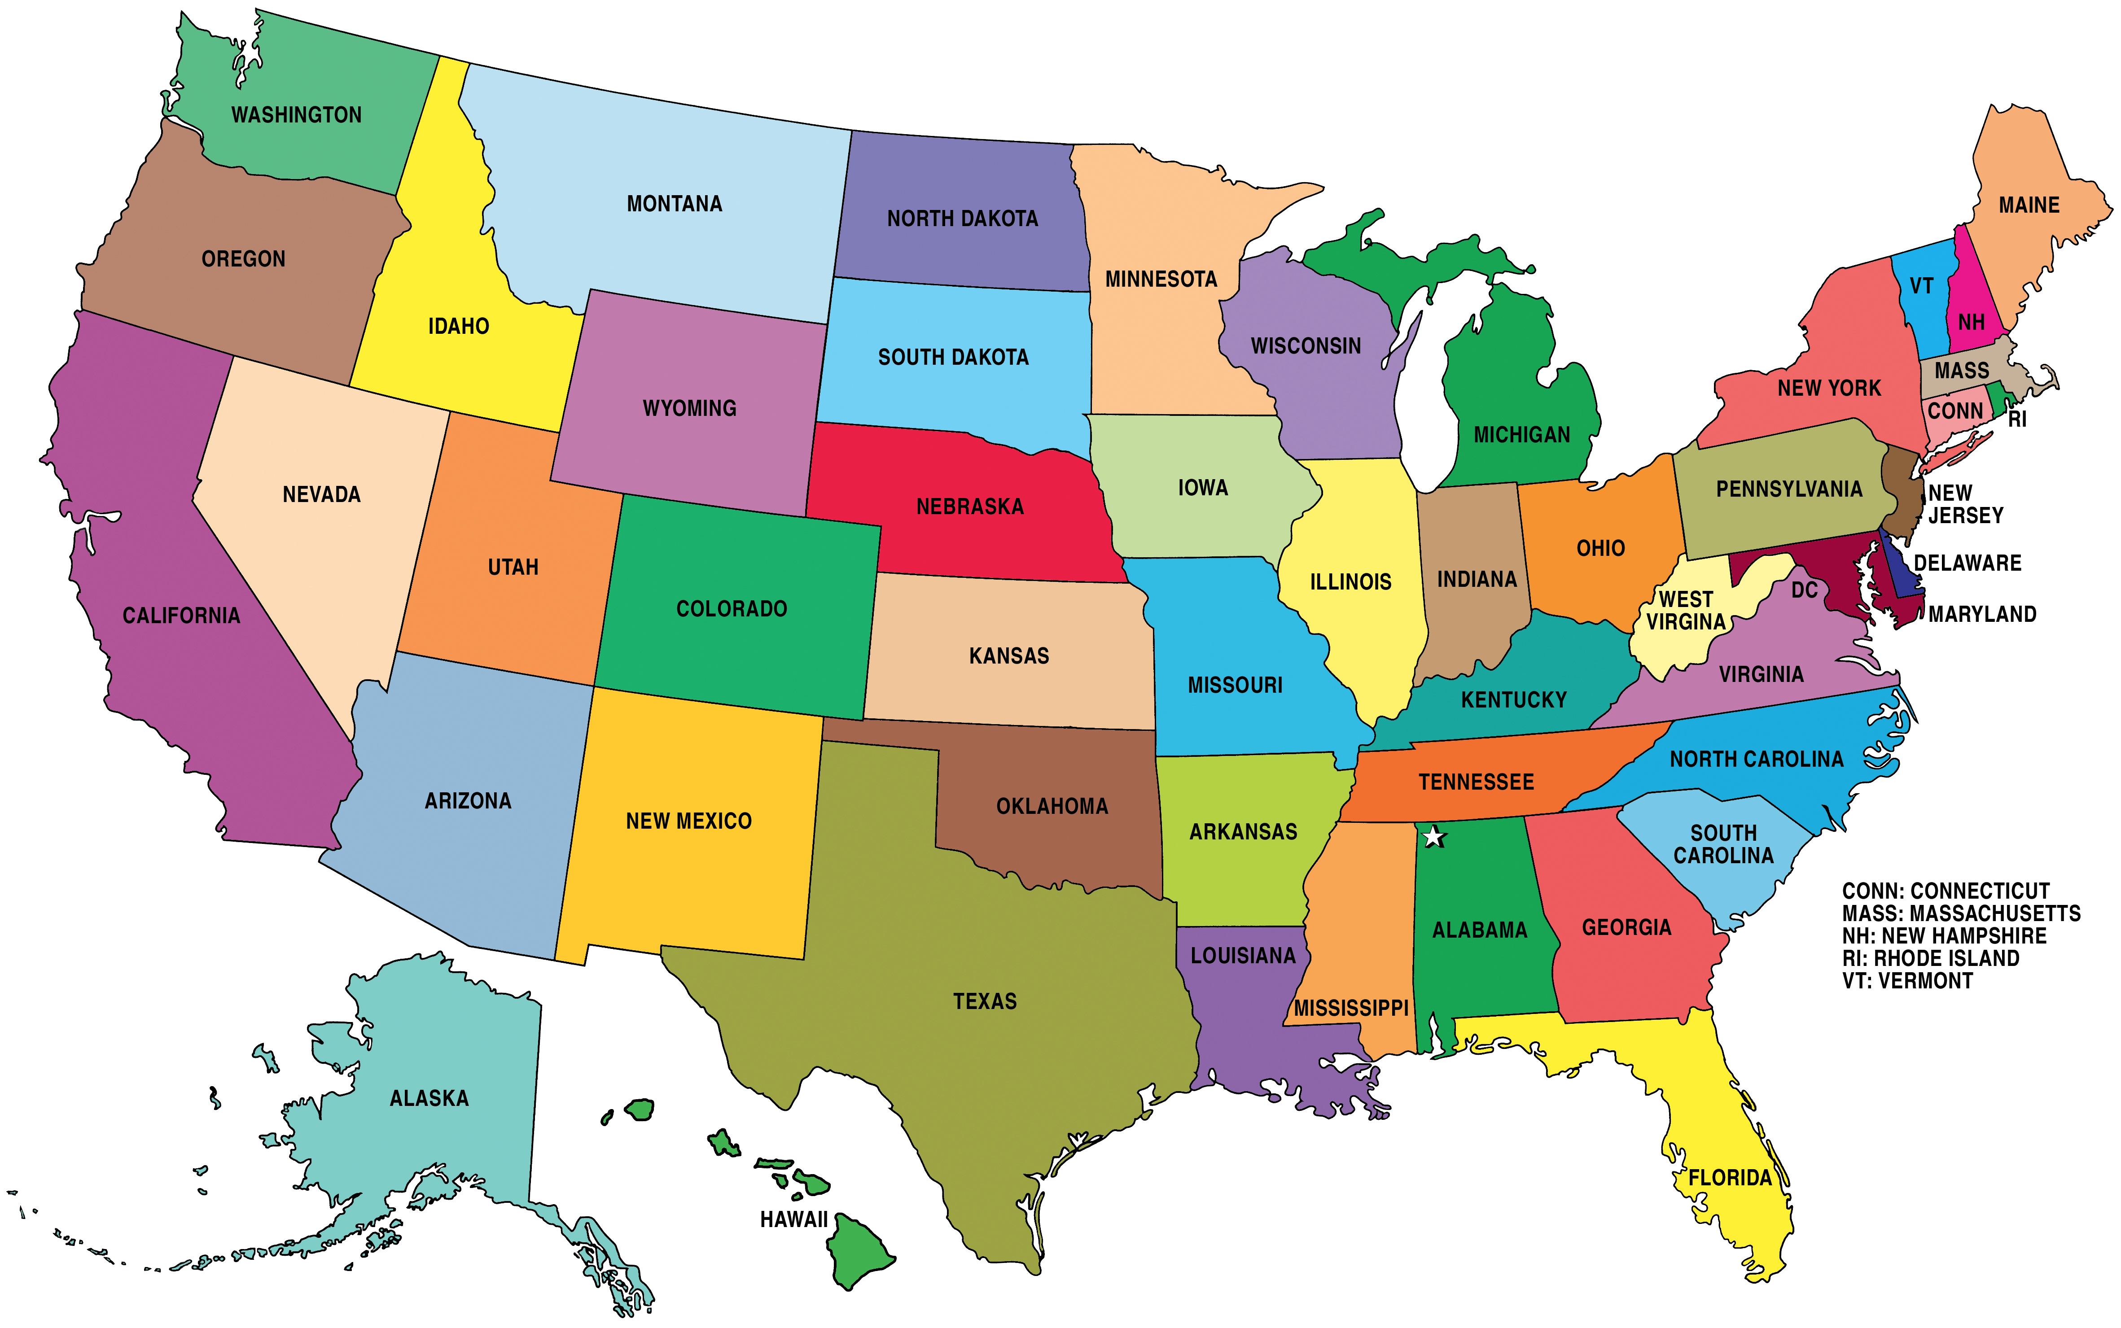
Sakai
Where is the user data??
What happens when there are 50 apps?
What if the app is free and hosted by a professor?
What happens if we stop paying the license?

Slide 11
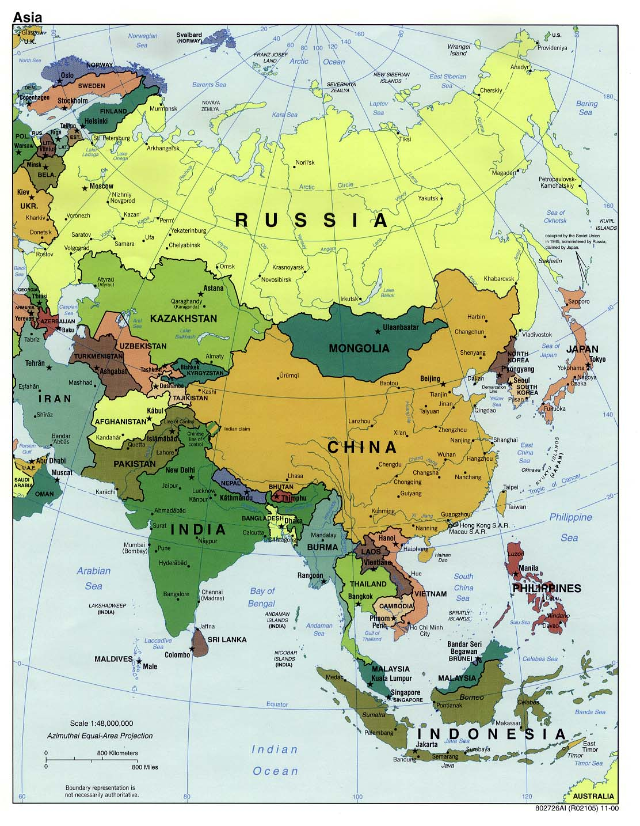
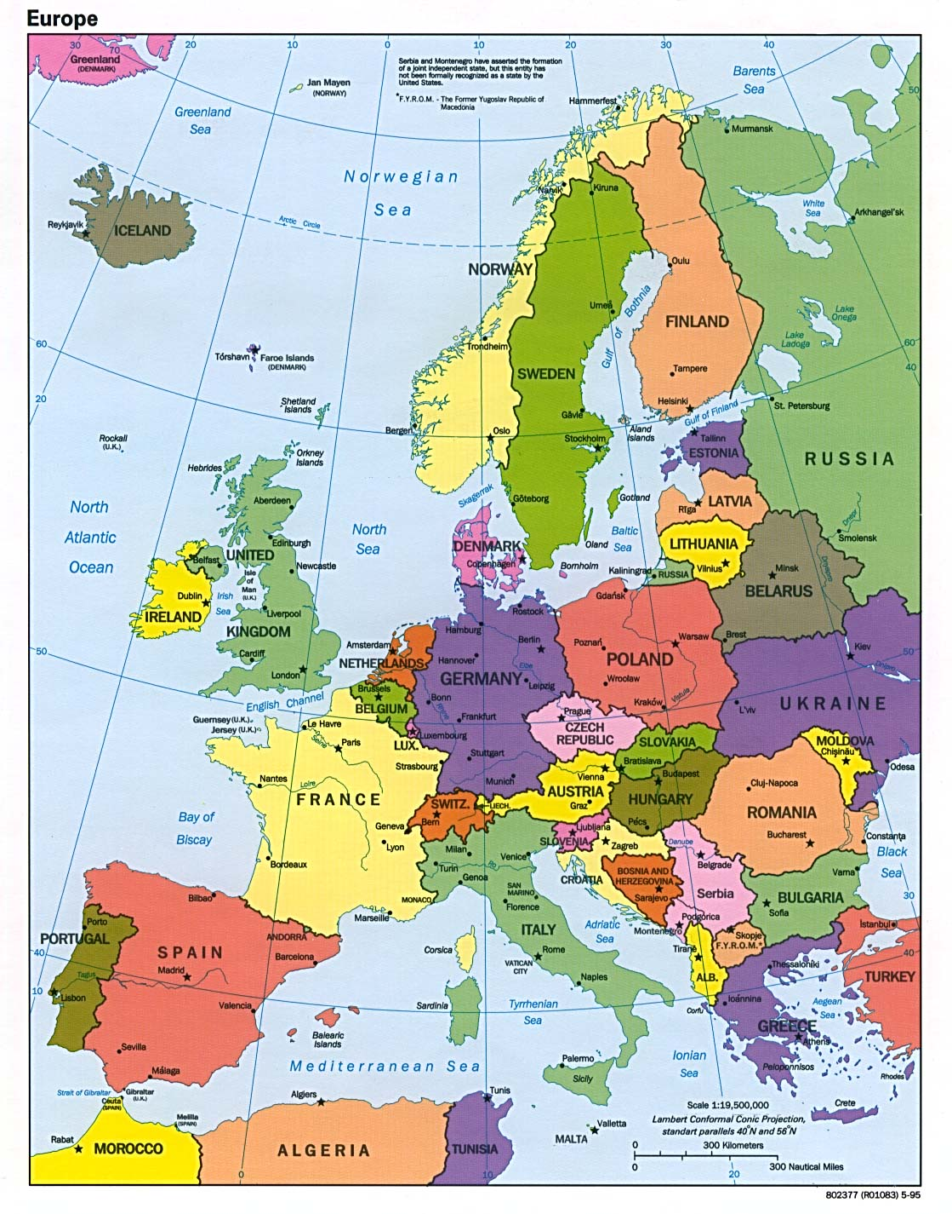
Neo-Colonialism
LTI-style

Slide 12
LTI 1.x versus LTI 2.x and Beyond
LTI 1.x – Three pages of spec and some "hello world" code
LTI 2.x – Several specs – multiple interactions
We will need to share common implementations across instructions
And what about Caliper, Casa, xAPI, etc. ??

Slide 13



Multiple LMS Campus + App Store
App
Store
Tool
Tool
Tool
Tool
...

Slide 14
Multiple LMS Campus + App Store
Tsugi
Hosting
Container
Tool
Tool
Tool
Install
App
Store
Tool
Tool
Tool
Tool
...

Slide 15
Multiple LMS Campus + App Store
Tsugi
Prod
Tsugi
Exp
Tool
Tool
Tool
App
Store
Tool
Tool
Tool
Tool
...

Slide 16
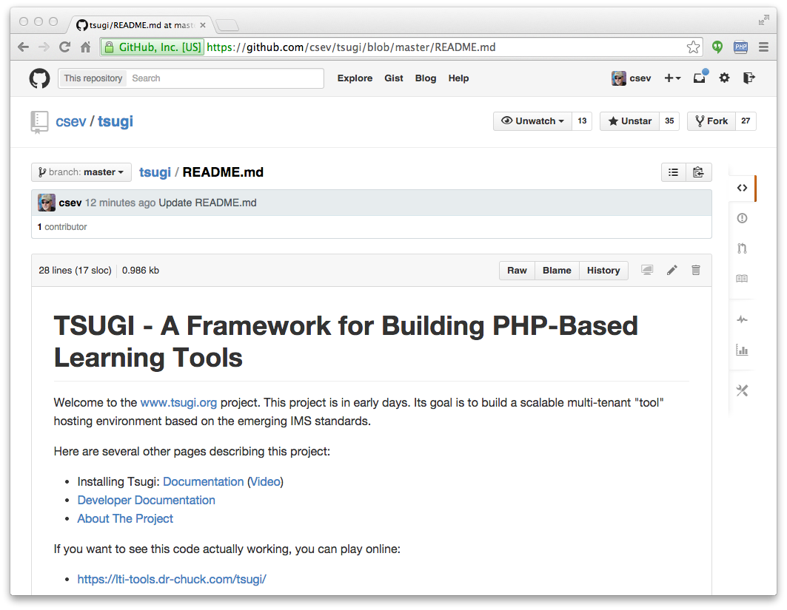
www.tsugi.org

Slide 17
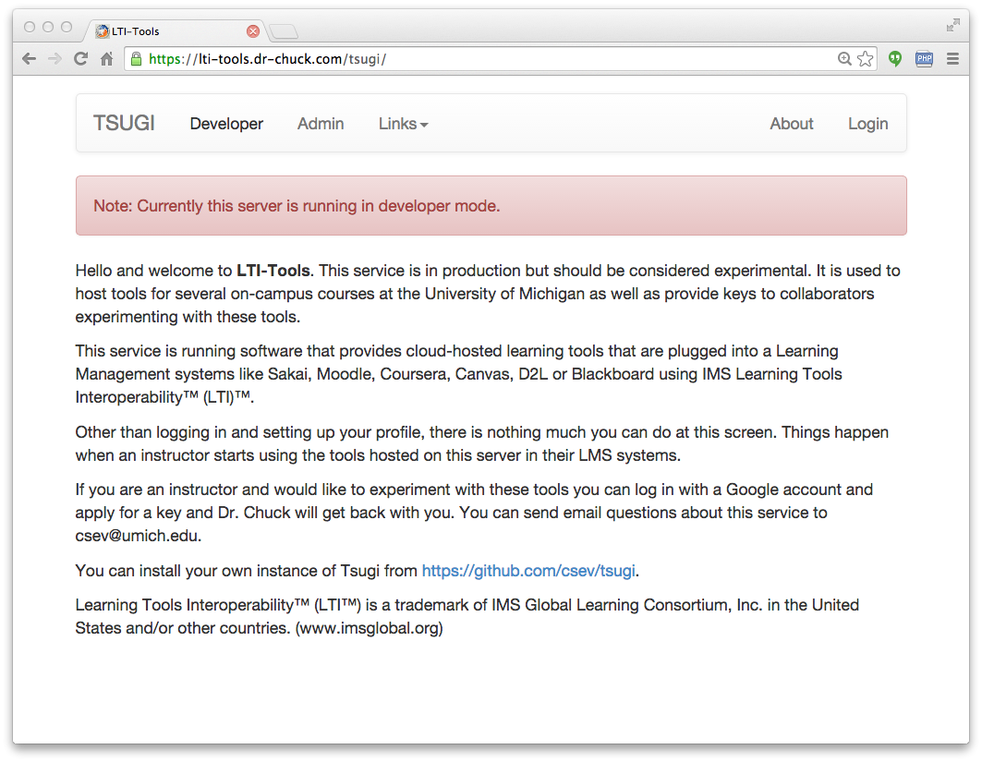

Slide 18
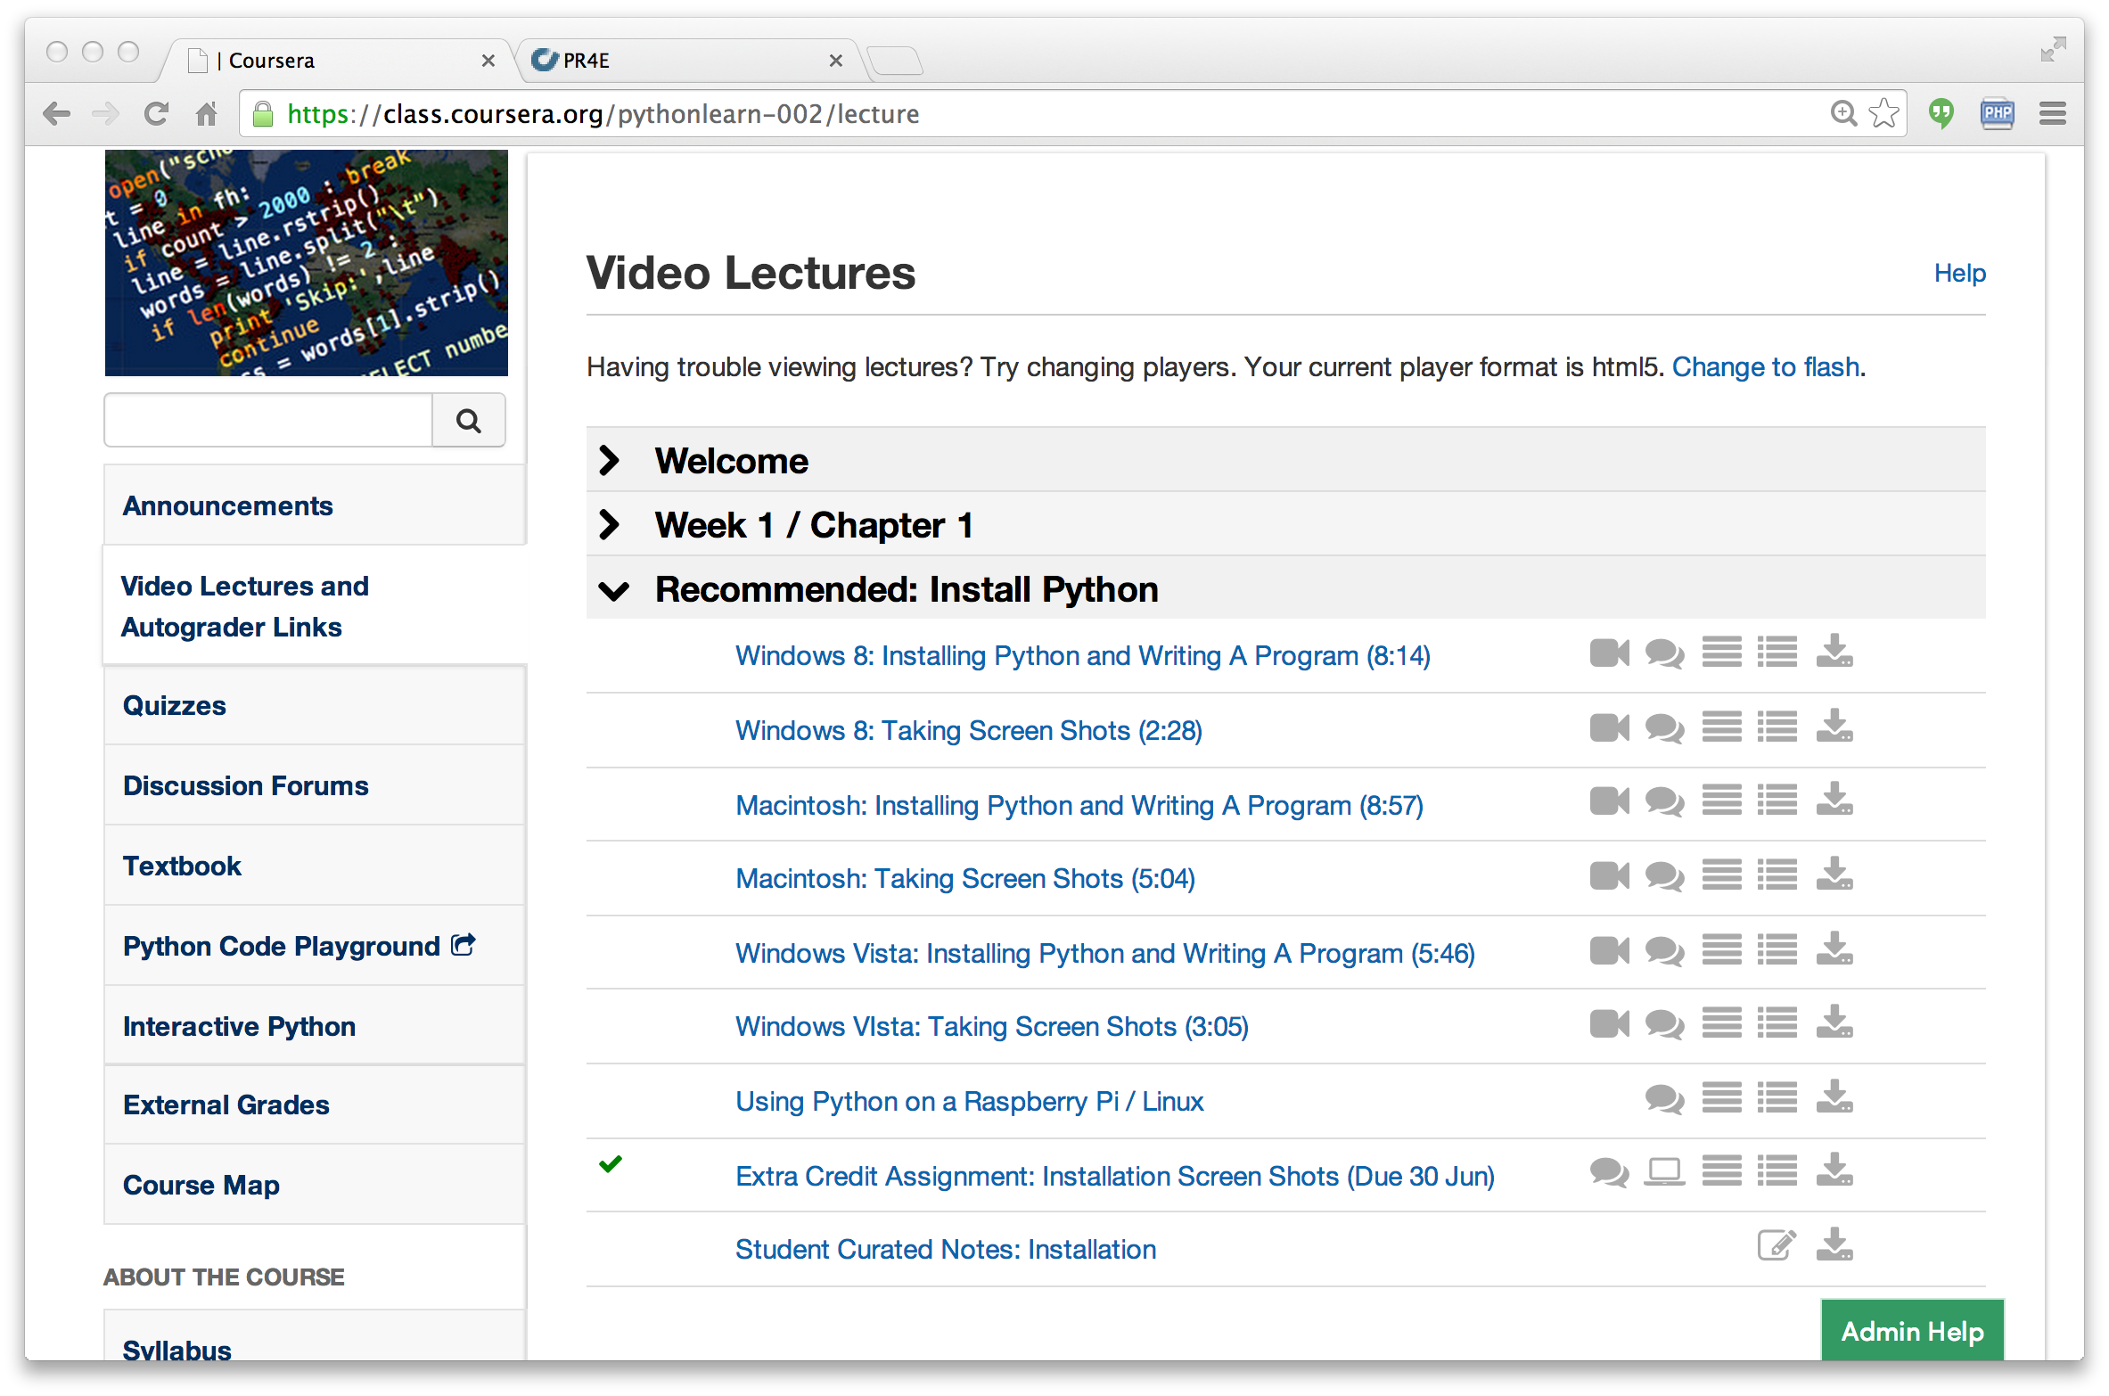

Slide 19
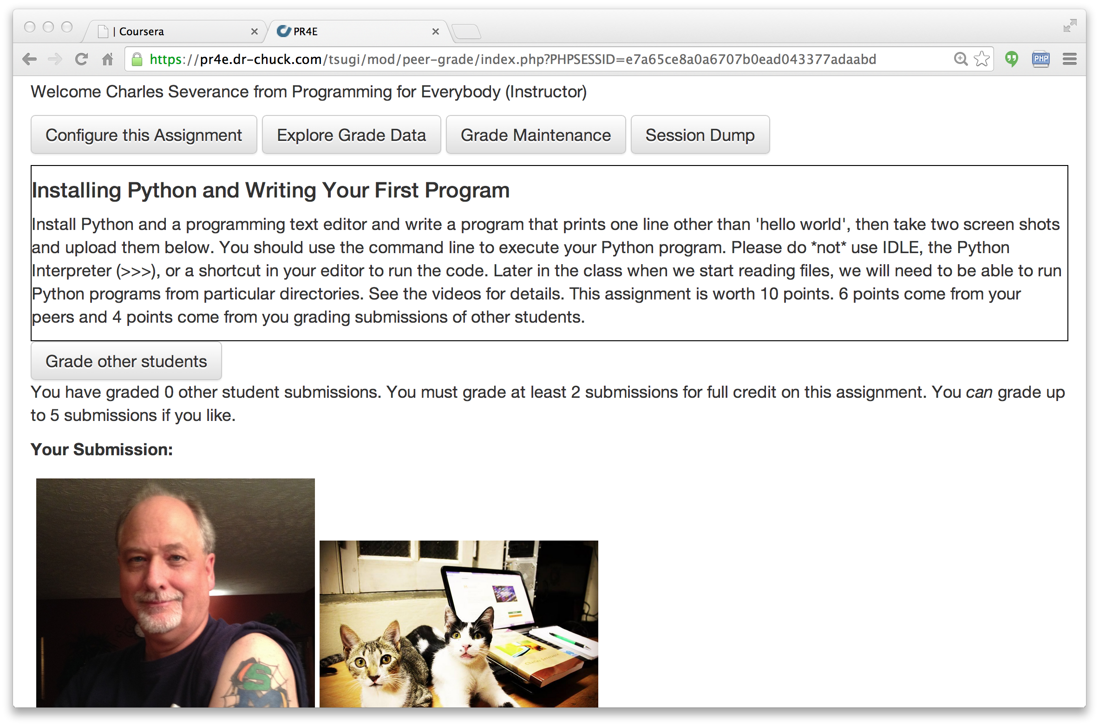

Slide 20
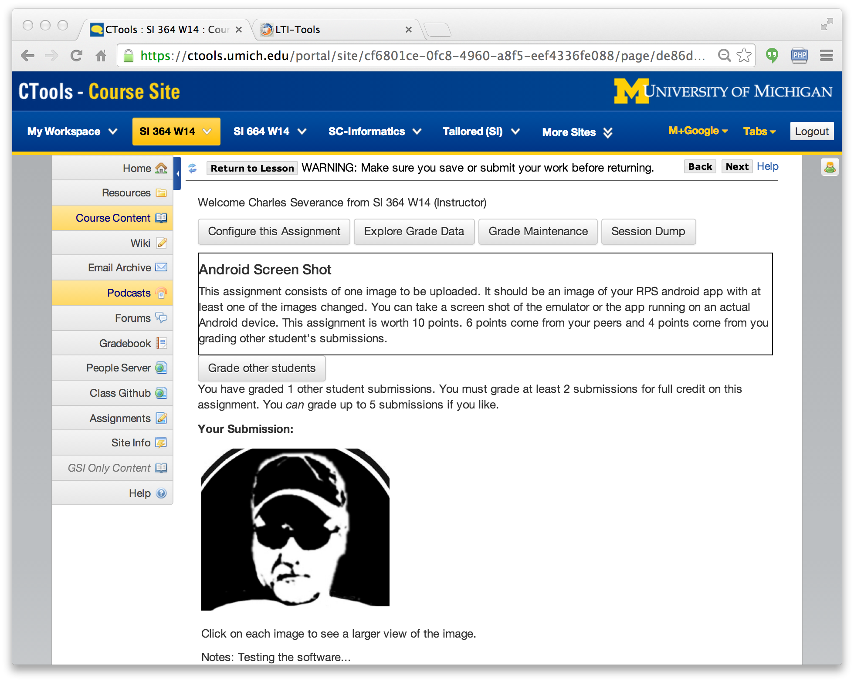

Slide 21
PHP Tsugi
Install / Configuration similar to Moodle
Emulate the Moodle APIs / Runtime
Multi-tenant
Cookie free (i.e. loves iframes)
Uses PDO with some rules about FK for easy cleanup
Auto-ddl feature to upgrade schema

Slide 22
PHP Tsugi Tool Code
<?php
require_once "../../config.php";
require_once $CFG->dirroot."/pdo.php";
require_once $CFG->dirroot."/lib/lms_lib.php";
use \Tsugi\Core\LTIX;
$LTI = LTIX::requireData(array('user_id',
'link_id', 'role','context_id'));
...
$OUTPUT->header();
$OUTPUT->bodyStart();
$OUTPUT->flashMessages();
$OUTPUT->welcomeUserCourse();
if ( $USER->instructor ) {
...

Slide 23
Demo
https://lti-tools.dr-chuck.com/tsugi/
Developer mode
Apply for keys

Slide 24
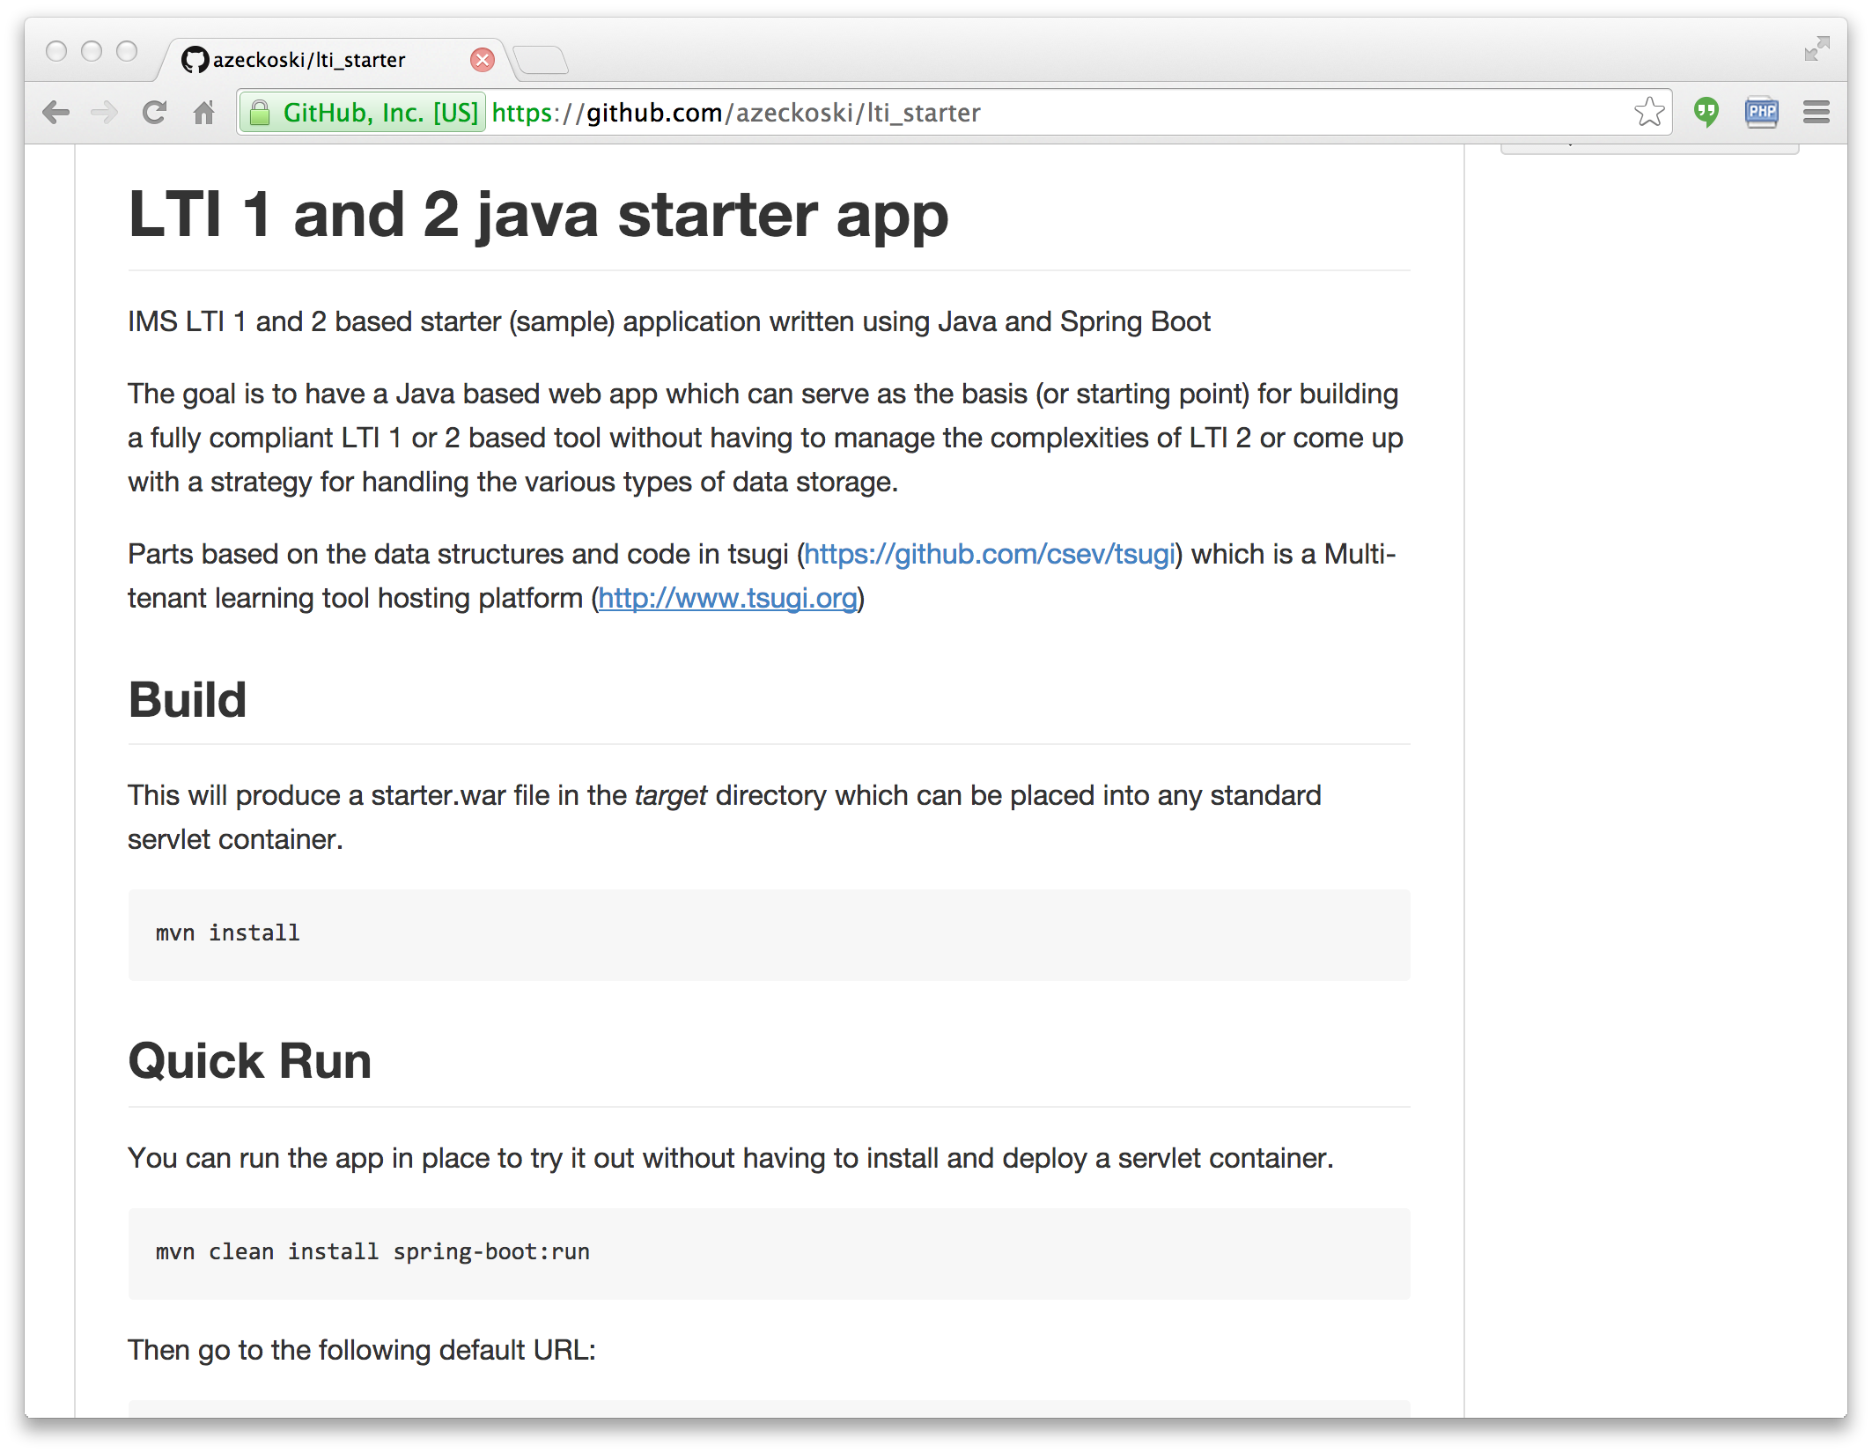
LTI Starter Kit

Slide 25
Deploying Starter Kit Apps
Tomcat
Amazon
EBS
LTISK
LTISK
Tsugi
Tool
Tsugi
Tool
Sakai
Sakai
LTISK
Sakai
Tool
Tsugi
Tool

Slide 26
Java Tsugi – Beyond Tomcat
Sakai
Once we have a good sense of how a Java LTI tool might look, we can look beyond Tomcat hosting...
Sakai
Sakai
Tool
Blackboard
B2
B2
Tool

Slide 27
Truly Portable Java Tools
Sakai
Tomcat
Sakai
LTISK
LTISK
Sakai
Tool
Tsugi
Tool
Tsugi
Tool
Blackboard
Amazon
EBS
B2
TSUGI/B
LTISK
B2
Tool
Tsugi
Tool
Tsugi
Tool

Slide 28
PHP Tsugi Next Steps
Architecture Review / Critique
IMS LTI 2.0 Support (done)
Improve Internationalization
xAPI support
IMS Caliper Support
IMS Casa Support
Moodle Outreach?
Tsugi is in 24x7 production and I can support a few experimenters on my servers.

Slide 29
Thank You...
www.tsugi.org

